Slide 1
Resume and Cover Letter Development
For Class Discussions/Video Development
Fall 2023
Peter Bennett – Director of Career Services

Slide 2
Agenda
Resume and Cover Letter Workshop
Today’s discussion has been developed to provide you with a better understanding of the resume and cover letter development process, which are important components to a successful internship/job search (in or out of the U.S.)
Purpose of resumes and cover letters
Keys to strong resumes and cover letters
Common problems/mistakes
What employers look for
Questions & answers

Slide 3
Importance of Resume in Job Search Process
Resume Attributes/Objectives
Foundational document – everything starts with the resume
A self-promotional marketing piece that outlines your education, work experiences (including internships and school projects), accomplishments and job-related interests
Must be authentic/honest – every line is fair game for interviewers to question
Chance for you to differentiate yourself from other candidates (STEM program, etc.)
Goal is to get an interview and advance in process!
It is NOT an application

Slide 4
Resume Development
Keys to Developing and Completing a Strong Resume
Should be one page, unless you have significant work experience (5+ years)
Must reflect key highlights of your education, coursework, internships, jobs, skills, activities, honors, publications, language skills and impactful community service/leadership efforts – CONCISELY!
Patience – takes multiple drafts to “get it right” – this is your personal brand document
Hiring companies are making investment decisions (talent) – your resume needs to answer the question “Why You?” for a particular job opportunity of interest
Must be visually appealing and easy to read

Slide 5
Resume Development
Keys to Ensuring Your Resume is Visually Appealing
Font Type: Use easy-to-read fonts such as Times New Roman, Arial, Calibri
Font Size: Stay between 10.5 – 12 point. Your name should be larger and bolded
Margins: Ideal margins are .75 around, but should not be smaller than 0.5
Style: Can use larger font for section titles and/or use bold, italics, or CAPS
Email: Once final, convert your resume to a PDF to preserve formatting
Professionalism: Do not use an inappropriate/unprofessional email address on your resume (i.e. “beerpongchamp@hotmail.com”)
KEY POINT: Make sure to clean up your social media profiles (Facebook, Instagram, etc.) so that you are only presenting a professional image. Many candidates screen themselves out of potential opportunities by neglecting this.

Slide 6
Resume Development
Keys to Developing and Completing a Strong Resume
Reverse chronological format is the most widely accepted type of resume
Include clear contact information – want to ensure that a recruiter can easily contact you when interested in you as a job candidate
Important to highlight your accomplishments – project goal(s), your role in project, number of people on team, timing, project outcome(s)
Do not list references – not necessary unless you advance in hiring process
Be consistent with all formatting (what goes on left and right side of resume, how dates are shown, locations, spacing, etc.)

Slide 7
Resume Development
Top “Pet Peeves” from Hiring Managers (April 2013 – Business News Daily)
Nondescript objectives
Small fonts
Formatting problems
Colored resume paper
Not following instructions (on applications)
Using the wrong tense
Not listing relevant details
A bad resume name
Inclusion of photo
KEY POINT: Recruiters spend 5-10 seconds reviewing a resume. These mistakes above will screen you out of the hiring process very quickly. Every word counts. No typos permitted. B+ is not good enough for a resume…has to be an A+.

Slide 8
Resume Development
Resume Tips
Chronological Resume
Correct and professional contact information
Contact information
No inappropriate email addresses!
Include GPA if 3.0 and above, list key coursework
Education
Omit high school beginning in 2nd year of college
Lead with action verbs
Use strong nouns/words
Experience
Quantify achievements where possible
Skills/Interests
Dissect the job description for clues – customize resume
Other Key Notes
Needs to be free of typos and grammatical errors
Don’t add references
One page fine for most resumes – two at most
No picture, or DOB
Notes:
Make sure contact information is correct. Choose a professional email address. Start sentences with action verbs. Use strong keywords and nouns.
Job description provides important clues on what is being looked for in candidates. Bullet points most effective. Do not include picture, or date
of birth. Keep format simple and easily read. Do not overuse “bold” and highlights in resume. Numbers, percentages and statistics get read. Avoid
overused phrases. NO TYPOS. Consistent formats.

Slide 9
Importance of Cover Letter in Job Search Process
Cover Letter Attributes/Objectives
Should answer the question – “Why should I hire you?”
States your intent to apply for a position or to an organization
Highlights why you are interested in the position
Clearly states why you think you are qualified for the position/organization based on your education and experience (in and out of the classroom)
Goal is to be invited for an interview (phone interview is increasingly the first step in the interviewing process)

Slide 10
Cover Letter Development
Keys to Developing and Completing a Strong Cover Letter
Contains additional information on your skills and experiences to apply for open positions
Should be customized for the specific position you are applying for – know what skills and experiences they are looking for and show why you are a great fit for the role
Use the same font you used for your resume – consistency is important
Don’t just repeat what has been clearly stated on your resume – you are highlighting key learnings in and out of the classroom and helping the recruiter understand the “fit” between you and the position
Be genuine/authentic/believable with your writing – recruiters can easily tell when someone is exaggerating or untruthful…”Since the day I was born I have wanted to teach third graders in Killingly, CT…”

Slide 11
Cover Letter Development
Keys to Developing and Completing a Strong Cover Letter
Before even starting your cover letter, review the job description carefully and create a list of skills and experience the employer requires
Evaluate your resume carefully and write down examples from your background that demonstrate that you have those skills and experience (“proof points”)
First paragraph – states why you are writing, how you heard about the job, and to which position you are applying
Second and third paragraphs – your opportunity to explain why you are qualified for the position. Discuss your knowledge, skills, and abilities as they specifically relate to the advertised position. You can highlight key pieces of your resume. Customize it for the specific position you are applying for – know what skills and experiences they are looking for and show why you are a great fit for the role
Final paragraph – your “call to action.” State your desire for an interview and outline the documents you have included, and thank them for considering your application

Slide 12
Cover Letter Development
Final Points on Development of a Strong Cover Letter
Cover letters are a demonstration of your writing ability – typos are not acceptable, again must be A+ quality for serious consideration
This is the first impression you are giving to the hiring manager – “only get one chance to make a first impression”
Never use slang or abbreviations – this is a professional document, which can be the difference between you being granted an interview or not
Make sure your contact details are current and always address the cover letter to a specific person if possible (do your research)
Use formal salutations such as “Mr. Jack Smith,” or Ms. Laura Bennington.” Do not use “To Whom it May Concern” or “Dear Sir or Madam” or “Dear Jack.” If you can’t find out after much research, then use the name of the department head (find online).
Unless specifically requested not to (rare), always send a cover letter and resume

Slide 13
How to stand out/differentiate yourself
What employers want (from job applicants)
“On the Ground” Feedback from Many Employers
Leadership
Skills
Intellectual/ Problem Solving
Skills
Results Orientation
Team Players
Strong Communication Skills (Oral and Written)
Technical Skills (Depending Upon Position)

Slide 14
How to stand out/differentiate yourself
What employers want (from job applicants) - continued
“On the Ground” Feedback from Many Employers
Experiential Learning Opportunities
Solid Academic Performance
Time Management Skills
Attention to Detail
Refined Personal Narrative
Networking Skills

Slide 15
Final Point
Any student/recent alum interested in help with resume and/or cover letter development can contact Career Services at pbennett@qvcc.edu
I would be happy to further discuss your skills and interests, set up a mock interview, or help with any aspect of your job or internship search.
I am here to support you!!

Slide 16
Questions?
Questions?

Slide 17
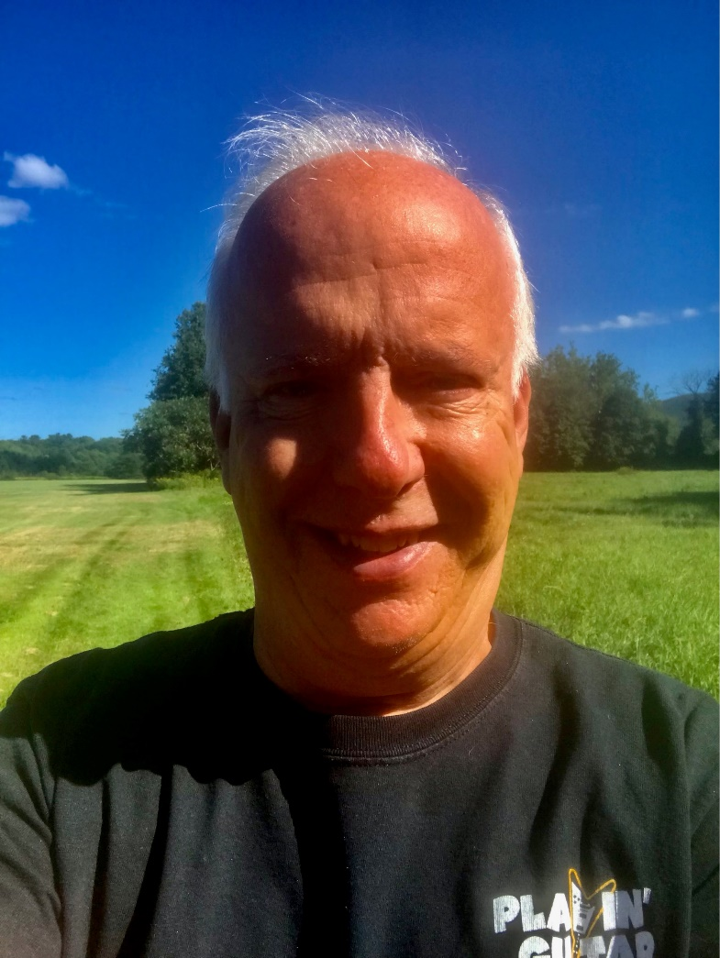
Career Services at QVCC
Contact Information – Peter Bennett – Director of Career Services
Email: pbennett@qvcc.edu
Phone: 860-932-4090
Location: Office W107D – Main Campus
Normal Office Location/Hours:
Danielson: Monday to Thursday
Willimantic: Friday
Appointments: 9am – Noon
Walk Ins: 1pm – 4pm
In-Person and Virtual Appointments Available!
I am here to help you!!

