Slide 1
Interviewing Excellence
For Class Discussions/Video Development
Fall 2023
Peter Bennett – Director of Career Services

Slide 2
Why am I here?
Get an edge! Engage! “Own” your career search process!
This seminar is designed to provide you with a general understanding of what you need to do in order to prepare well for interviews and convince a company that you are THE best fit for the advertised position.
YOU (Sell Side) need to convince a company (Buy Side) to hire you
How to prepare for business interviews
Review of typical questions and optimal responses
Key dos and don'ts that every interviewee must know
Art and science of interviewing
Review of Some Short Videos – What NOT To Do! What TO Do!
Practice, Practice, Practice – Interviewing!
Role play interviews with classmates/friends/family
Career Services is available for mock interviews (in-person or virtual)
Questions and Answers

Slide 3
Getting ready for interviews
Know your interviewer
What firm are you interviewing with?
What position are you applying for?
Quantitative versus programming
Individual work versus team-based
Who are you interviewing with?
Recruiter versus future co-worker / boss

Slide 4
Getting ready for interviews
Know yourself
Your strengths
Your weaknesses
Your interests

Slide 5
Getting ready for interviews
Know yourself
Strengths
What do you like to do?
Academics? Arts? Social activities? Sports? Like what?
Analyzing problems and finding solutions? Examples?
What are you good at?
What have you received accolades/awards for?
What are examples that demonstrate this?
What have you done to build on and develop your strengths?
Concrete examples
Weaknesses
What are you not good at?
Do you have any academic gaps or missing social activities that would need to be explained?

Slide 6
Getting ready for interviews
Know yourself
Know about your job and the interviewer
Resources
Know yourself
Your strengths
Your professional interests
Your weaknesses
Your resume
Alumni database
Talk to alums
Career Services
Attend workshops
Company website
Your passion
Job postings
LinkedIn/Facebook..
Google
YOUR
STORY!

Slide 7
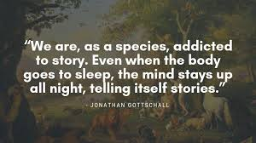
Getting ready for interviews
No story = no offer
Your desire for a position should be expressed via a coherent articulation of your professional ambition, with supporting anecdotes from your academic, personal, and professional journey.
Your story should do the talking

Slide 8
Getting ready for interviews
Sample story
Interviewing for accounts payable analyst position
Candidate profile:
23 years old
May 2023 QVCC graduate
Double major in Accounting and Performing Arts
3.3 GPA
Sports and music enthusiast
Fluent in English and Spanish

Slide 9
Getting ready for interviews
Potential story highlights – laying down the foundation
Academic interests reflect a quantitative and research disposition, with an ability to analyze and solve problems
Sports and musical interests reflect a passion for being a member of a team and collaboration
Strong GPA (and any other achievements) reflects intellectual rigor and work-ethic
Spanish, if used to pursue interests or studies, demonstrates cultural fluency and servicing of a larger customer base

Slide 10
Getting ready for interviews
Potential story highlights – why this means they should hire you
You are interested in an accounts payable analyst role, which rewards hard work and allows you to incorporate both your qualitative and quantitative skills in a way that very few positions can
Additionally, the position provides exposure to both internal and external business activities, which has been of high interest to you during your core academic studies
Each point must be supported by a reserve of anecdotes! Only way to make the story genuine.

Slide 11
Getting ready for interviews
Potential story highlights – what your story should avoid
Harping on one dominant strength (one dimensional approach)
Example: Passion for guitar playing is okay because it demonstrates dedication, but don’t take it too far
Example: High GPA is good because it reflects focus and dedication, but don’t oversell it
Grandiosity/Arrogance
They will call you on it and ask you to back it up
Bringing up topics you aren’t sure about
If your favorite class was Macroeconomics, you better be able to answer related follow up questions
Highlighting ANY weaknesses

Slide 12
Getting ready for interviews
Potential story highlights – general interview techniques
Practice – over and over and over
NEVER go to an important interview without practicing answers from a list of questions with friends or a career coach first
Practice in front of a mirror
When possible, schedule more important interviews after a few “tune ups”
Nobody is a good interviewee the first time around
Schedule a mock interview with Career Services

Slide 13
Getting ready for interviews
Open-ended questions
In an interview, you will be asked many types of questions, many of which will be open-ended questions
They are your chance to shine – tell them who you are on your terms
Opportunity to steer the conversation
Opportunity to tell the story – YOUR story

Slide 14
Getting ready for interviews
“Tell me about yourself”
“Walk me through your resume”
This is an opportunity to tell your story
Story should have a progression and be coherent
Focus on relevant coursework and experience
How this all naturally led to your interest in this position

Slide 15
Getting ready for interviews
“Why this position / industry / company”
Directly connect your story to this position
If you’ve already told your story in previous questions, focus on how your strengths and passions would make a contribution to this firm
Depending on the position you’re applying to, highlight different strengths
Each position is a unique opportunity – understand the business, your role within the business, and your strengths, and then connect the dots
Recruiter checking to see if you understand and are serious about this role

Slide 16
Getting ready for interviews
“What is your greatest strength”
Don’t be afraid to toot your own horn – that’s what they are asking for
However, do not overdo it (“I am the greatest student at my school”) – always back up statements with examples and infuse humility (“of course, I am eager to learn more”)
Should highlight positive traits using anecdotes related to your story
“Through my extensive team project work in my accounting classes, I found that I enjoyed and excelled at motivating the team and providing leadership. There was a specific time where….”

Slide 17
Getting ready for interviews
“What is your greatest weakness”
Must sell weakness as a strength without sounding rehearsed or disingenuous
Very difficult question to answer
Possible weakness: Do you always need to know how something works, but you recognize that under deadlines, this thirst for knowledge might compromise the task at hand?
The key with weaknesses is that you recognize them and have worked to correct them
Caution: have a follow up “weakness”; interviewers have been known to counter with “that’s not really a weakness, tell me a real weakness”
Never admit a damaging weakness (always late, no attention to detail, can’t play with others, etc.)

Slide 18
Getting ready for interviews
Where do you see yourself in 5 years?
Show that you understand the career progression
Answer depends on the role you are interviewing for
OK to say that your near-term experience in the role you’re interviewing for will help to identify exact career paths, but you need to express a general desire to stay within the industry, and reaffirm that it is because of the unique opportunities, experience, and exposure this position provides that you will be able to move towards your career goals

Slide 19
Getting ready for interviews
“Why should we hire you?”
“What sets you apart?”
This is another opportunity to tell your story
Although the question seems to ask for it, avoid speaking negatively about others – focus on your strengths, not on the weaknesses of others

Slide 20
Getting ready for interviews
Job Interview Video Example – From the “Pursuit of Happyness” Movie
Google “Videos of Interview in Pursuit of
Happyness Movie” featuring Will Smith to see a powerful example of overcoming obstacles to make a positive impression and interview with excellence.

Slide 21
Getting ready for interviews
“Why do you want to work here?”
Do your research about the company you interview with
Know the organizational structure, culture, recent news, name of CEO, annual revenues, competitors, head of the group, etc.
Company website (make sure to read press releases), and LinkedIn.com are great resources
Tie to your story
This is another opportunity to tell your story

Slide 22
Getting ready for interviews
“Where else are you interviewing?”
Do not mention unrelated companies/roles
Mention only other similar firms – limit specifics, and never criticize other firms
Reiterate your enthusiasm for the position with the interviewer
Reiterate your enthusiasm for the company you are interviewing with

Slide 23
Getting ready for interviews
Some Common Interview Questions
“Tell me about a risk you have taken in your life”
May be an opportunity to explain holes in your resume
“Describe your 3 best personality traits”
If you say “sense of humor,” be ready to tell a joke or share a funny scene from television or a movie
“Describe a time in which you failed at something?”
Pick a failure that does not reflect a fundamental weakness
May also be an opportunity to explain problematic areas in your resume

Slide 24
Getting ready for interviews
“Common Interview Questions (Continued)
“When is it better to follow than to lead?”
You will have to follow a lot as an entry level professional, so provide examples that reflect your understanding that deferring to the expertise of others is important
“Who are the 3 most influential people in your life?”
Stick to personal relationships – family, friends, mentors, professors, be ready to explain why
“Who do you most admire?”
Avoid controversial figures
“How would others describe you?” Strengths/Weaknesses? In three words?
“What book are you currently reading?”

Slide 25
Getting ready for interviews
“What questions do you have for me?” (at end of interview)
Do not ask logistical questions (i.e., what are health benefits, salary, vacation, etc.)
Always have several questions prepared, and some new ones may emerge during the interview (as they come up remember them for when the interviewer opens the floor to your questions)
Consider asking questions about the interviewer’s experience (be careful not to ask inappropriate questions):
“What was the biggest adjustment you had to make when starting out in your role at this company?” is appropriate
“Can I expect a bonus and promotion after three months in the role?” is inappropriate
Consider asking questions about the company - this is an opportunity to show the interviewer that you have done your research

Slide 26
Getting ready for interviews
Questions to ask (sample)
What types of personal attributes have you observed in successful performers in your organization?
What parts of your position have you found most exciting / interesting?
How would you describe the firm’s culture?
What do you see as the top two or three priorities for the selected candidate within the first six months on the job?
What is your firm’s strategy / how is your firm positioned vis-à-vis the current challenges in your industry (insert topical issue here)

Slide 27
Getting ready for interviews
Questions not to ask (sample)
Do not ask your interviewer how much money they make
Do not ask your interviewer about their political affiliation or position on controversial issues (such as abortion, death penalty, and so forth)
Do not ask your interviewer about their marital status or whether they have children
Do not ask questions you could have easily found the answers to by attending an info session, reading the company’s website, reading the news, or doing company research, such as:
How many employees work at your firm?
Where is your headquarters located?
Do not ask irrelevant questions just to ask questions

Slide 28
Getting ready for interviews
Aggressive Questions
Some interviewers will ask questions more aggressively than you’re comfortable with
Remain confident
Stay calm
Most aggressive questions are just standard interview questions wrapped in a blanket of aggressiveness
“Why didn’t you take advanced Excel classes if you knew you wanted to go into financial modeling so much?”

Slide 29
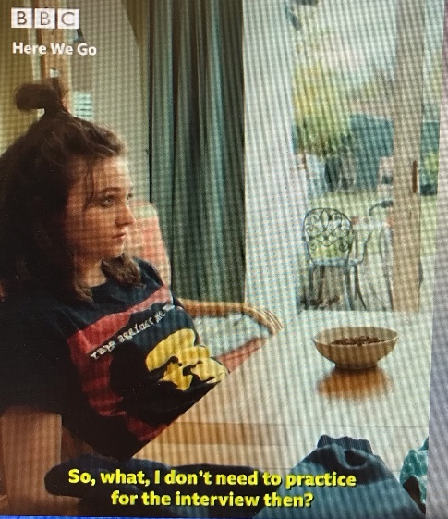
Getting ready for interviews
What Not to Do – Video!
Google “Hilarious Job Interview - Here we go – honesty – by BBC” to better understand the importance of preparing for interviews, knowing what not to say, and being able to tell a compelling story on why you are a good fit for a particular job. This candidate is not prepared!

Slide 30
Getting ready for interviews
Tips for Success
Google “How to Succeed in Your Next Job Interview – Tori Dunlop” to gain tips on how best to prepare to ace your interview. Preparation is the absolute key to success, and Tori gives some excellent advice on specific steps to take so that you present your capabilities with confidence.

Slide 31
Interview Follow Ups
Can Make the Difference between “Yes” or “No” in the Hiring Decision!
Send an email thank you note within 24 hours to the interviewer(s)
Reinforce your strong interest in the position and company
End your note with a firm “call to action,” such as “I look forward to hearing back from you concerning next steps in the hiring process”

Slide 32
Getting ready for interviews
Let’s recap
Answering open ended interview questions
Bring it back to your story
Provide anecdotes
Answering closed-ended questions
Answer directly
Put positive spin on everything
Interview follow-ups
Email thank you note to interviewer(s) within 24 hours
Reinforce your enthusiasm for the role/company

Slide 33
Getting ready for video interviews
20 Tips for Excellence - Regina Borsellino
Prepare like you would for an in-person interview
Dress to impress
Test your technology
Set up your shot
Don’t sit too far or too close
Prep for optimal eye contact
Check for glare
Practice, practice, practice
Pay attention to how you sound
Write out a few notes
Minimize interruptions
“Show up” 10 minutes early
Start off with a “digital handshake”
Acknowledge the differences
Maintain good posture
Use your face to show you are engaged
Let the other person finish speaking
Signal when your answers are completed
Explain any long pauses
Treat your video interview like a conversation

Slide 34
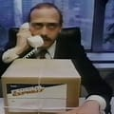
Getting ready for interviews
Find Your Own Rhythm of Speech – Federal Express Commercial
Google “Fedex Commercial with John Moschitta” to see a powerful and funny example of someone speaking too quickly for an interview situation. It is important to find your own rhythm of speech when interviewing, and realize that people tend to speak faster when nervous.

Slide 35
Final Point
Any student/recent alum interested in help with interviewing can contact Career Services at pbennett@qvcc.edu
I would be happy to further discuss your interviewing strategy, set up a mock interview, or help with any aspect of your job or internship search.
I am here to support you!!

Slide 36
Questions?
Questions?

Slide 37
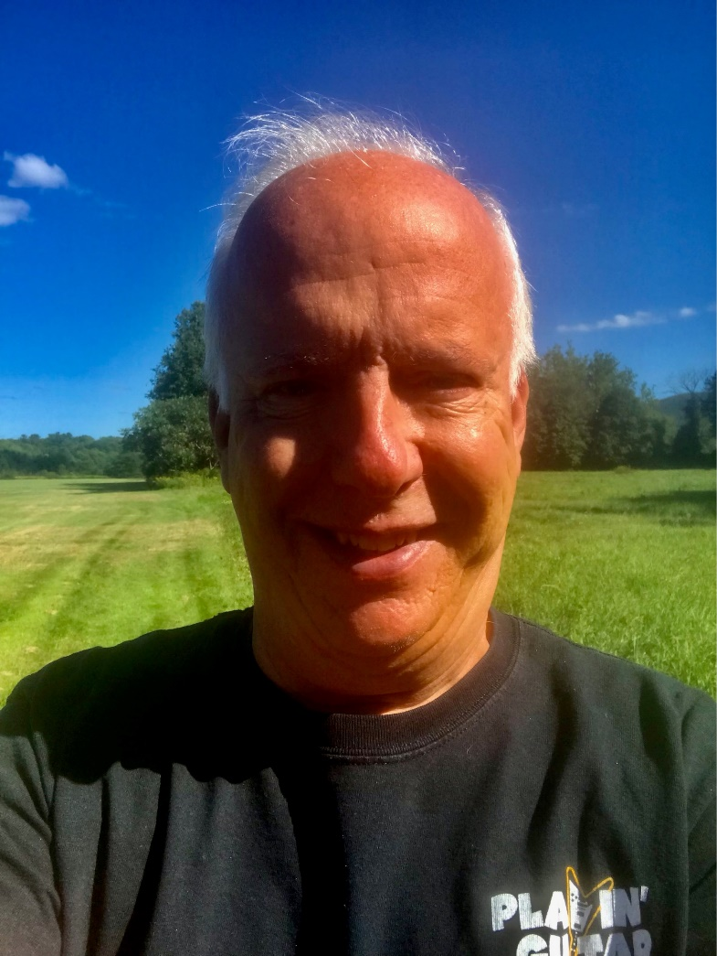
Career Services at QVCC
Contact Information – Peter Bennett – Director of Career Services
Email: pbennett@qvcc.edu
Phone: 860-932-4090
Location: Office W107D – Main Campus
Normal Office Location/Hours:
Danielson: Monday to Thursday
Willimantic: Friday
Appointments: 9am – Noon
Walk Ins: 1pm – 4pm
In-Person and Virtual Appointments Available!
I am here to help you!!

